Slide 1

Portland , OR Housing & Affordability 2019-2023
Group 2: Devin Brindle, Asres Dagnew, Iyer Megan, Forrest Margulies

Slide 2
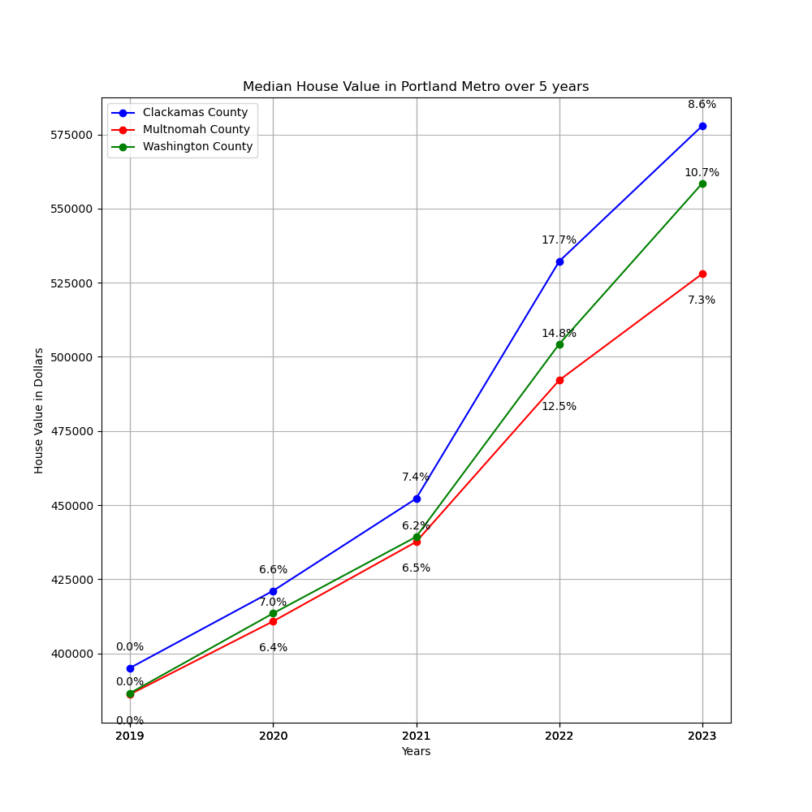
This data shows that over the five-year span from 2019-2023 the median home value in Clackamas, Washington, and Multnomah counties saw a significant increase.
Total Increases are as follows:
Clackamas – 40.3%
Washington – 38.7%
Multnomah - 32.7%
Source: USCensus.gov (n.d.)

Slide 3
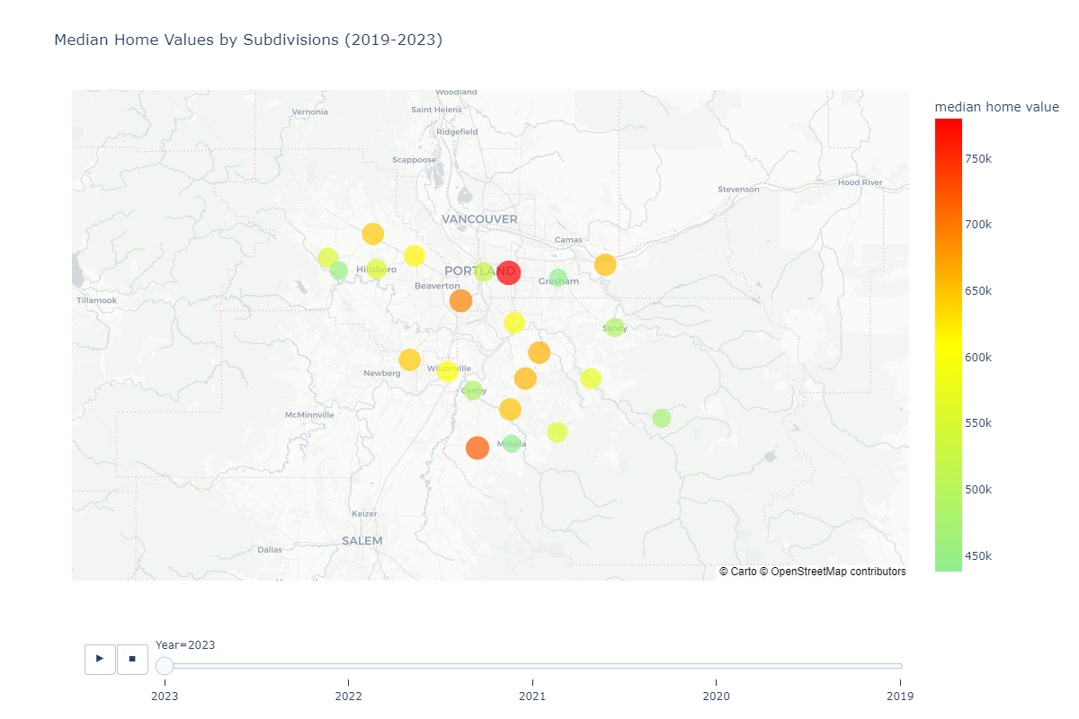
Interactive map showing median home values across all 23 county subdivisions
Highest Median Home Value (2023) Skyline, Multnomah, Oregon – $780,100 Yoder, Clackamas, Oregon – $719,800 Portland West, Multnomah, Oregon – $694,000 Wilsonville, Clackamas, Oregon – $605,600
Lowest Median Home Value (2023) Gresham, Multnomah, Oregon – $438,300 Molalla, Clackamas, Oregon – $438,300 Forest Grove-Cornelius, Washington, Oregon – $457,200 Canby, Clackamas, Oregon – $484,700
Source: U.S. Department of Housing and Urban Development. (n.d.)

Slide 4
Did changes in housing inventory influence home values from 2019 to 2023?
Null Hypothesis: Changes in housing inventory did not significantly influence median home values in Washington, Clackamas, and Multnomah Counties from 2019 to 2023.
Alternative Hypothesis: Changes in housing inventory had a statistically significant influence on median home values in Washington, Clackamas, and Multnomah Counties from 2019 to 2023.

Slide 5
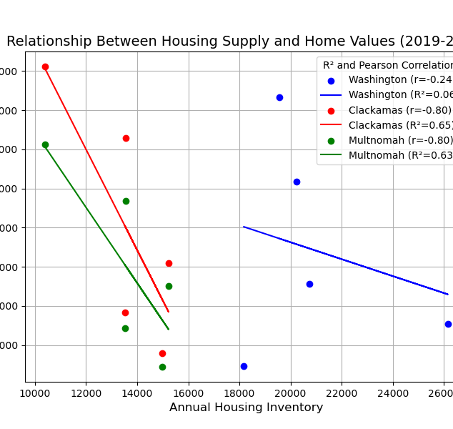
Significant correlation in Clackamas and Multnomah → As inventory decreased, home values rose.
Washington County had almost no relationship (R² = 0.0554), meaning inventory changes did not meaningfully impact home values.
Sources: USCensus.gov (n.d.), Federal Reserve Bank (n.d.)

Slide 6
Did changes in mortgage rates influence median home values from 2019 to 2023?
Null Hypothesis: Changes in mortgage rates did not significantly influence median home values in Washington, Clackamas, and Multnomah Counties from 2019 to 2023.
Alternative Hypothesis: Changes in mortgage rates had a statistically significant influence on median home values in Washington, Clackamas, and Multnomah Counties from 2019 to 2023.

Slide 7
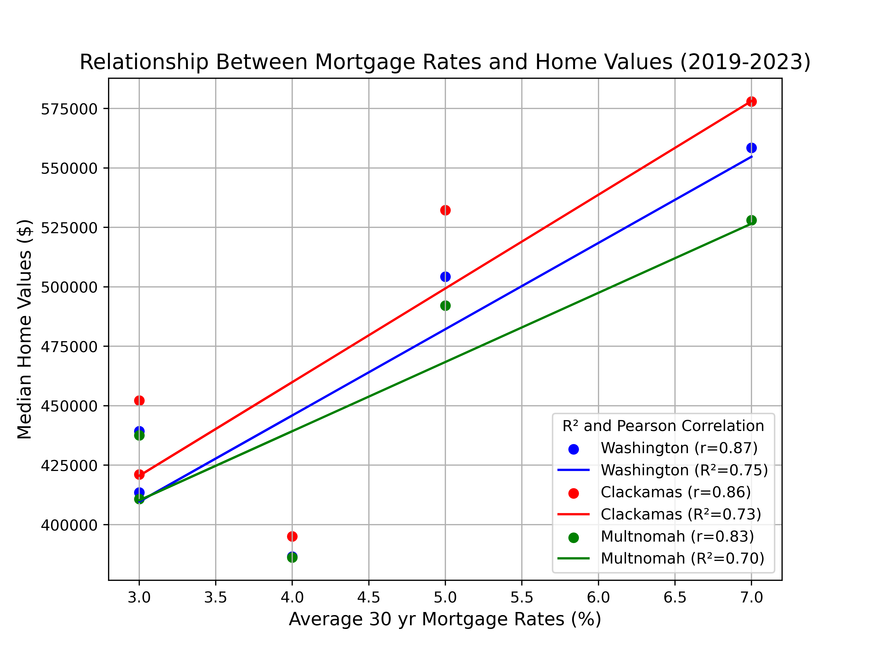
There is a strong positive correlation (r > 0.83) between mortgage rates and home values.
High R² values (~70-75%) indicate that mortgage rates explain a significant portion of home price variation.
Sources: USCensus.gov (n.d.), Federal Reserve Bank (n.d.)

Slide 8
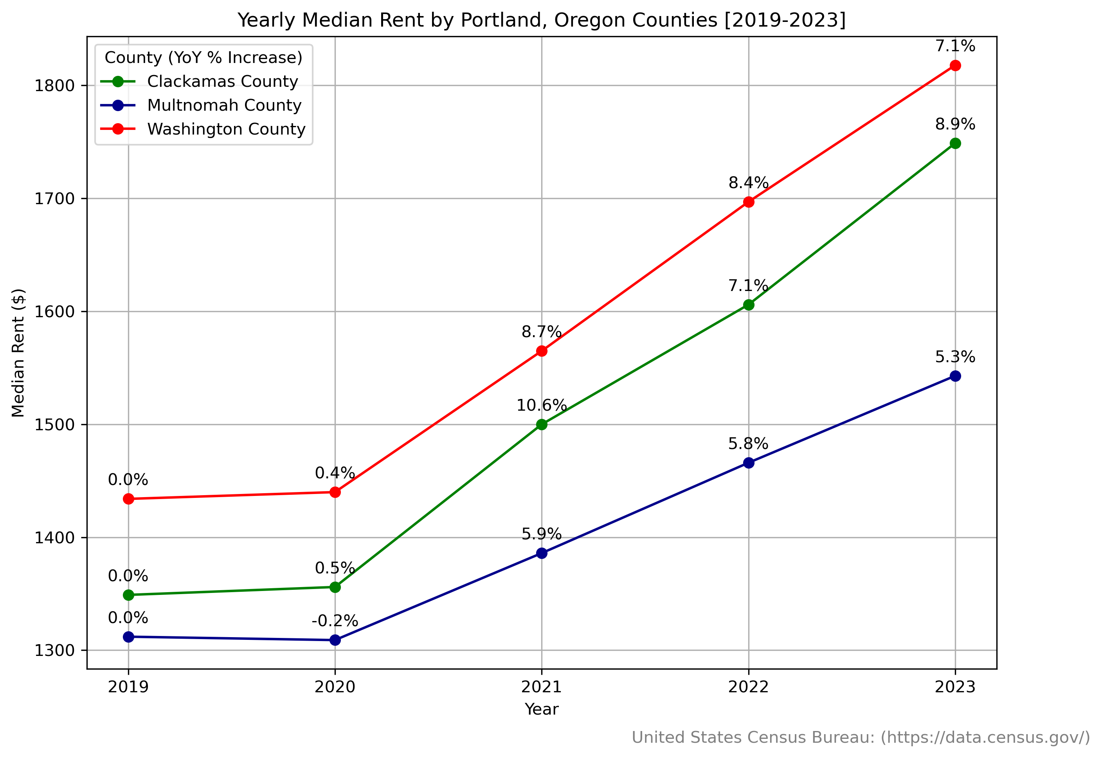
Year over year percent increases based off previous year's rent.
Sources: USCensus.gov (n.d.)

Slide 9
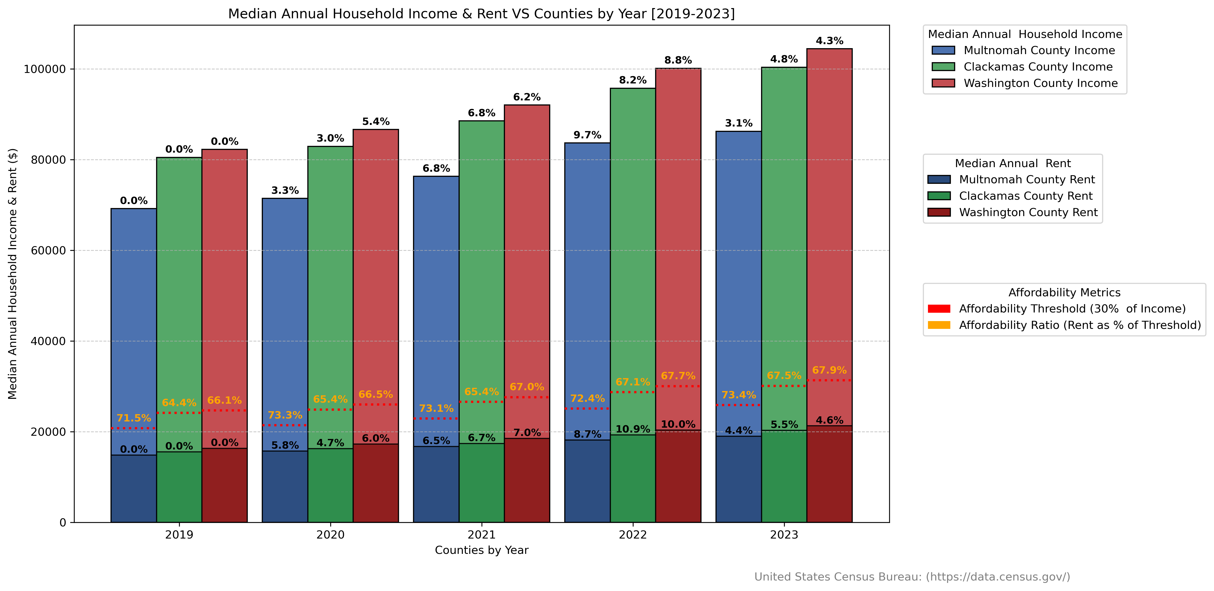
Year over year percent increases in relation to Annual Median Household Income
Sources: USCensus.gov (n.d.), Herbert, C. E., Hermann, A., & McCue, D. (2018)

Slide 10
According to U.S. Department of Housing and Urban Development, the general rule of thumb for housing affordability based on the home value-to-income ratio is: Affordable: ≤ 3.0 → The home price is three times or less than the household's annual income. Moderately Affordable: 3.1 - 5 → Still manageable but may require some financial adjustments. Severely Unaffordable: > 5.0 → Indicates significant housing affordability issues, where home prices are five times or more than annual income. Homeownership may require excessive debt, high mortgage payments, or compromises in other financial areas.

Slide 11
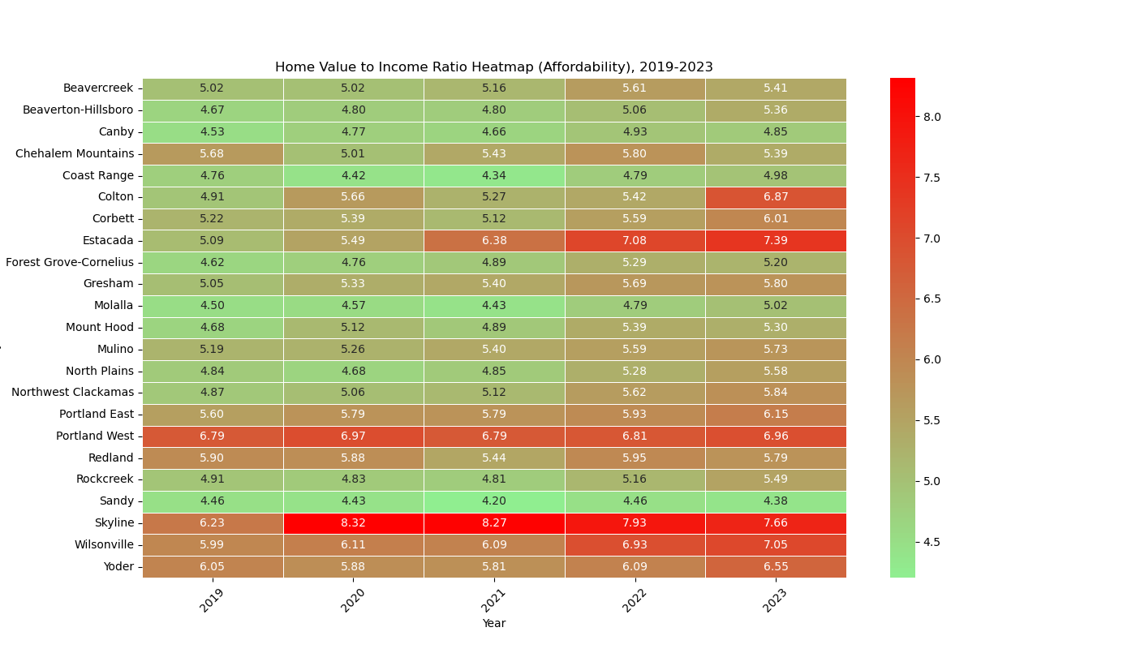
Source: U.S. Department of Housing and Urban Development. (n.d.)

Slide 12
Affordable Subdivisions (2023)
These areas have the lowest home value-to-income ratios, making them moderately affordable:
Sandy, Clackamas – 4.38
Forest Grove-Cornelius, Washington – 5.20
Molalla, Clackamas – 5.02
Beaverton-Hillsboro, Washington – 5.36
Mount Hood, Clackamas – 5.30
Least Affordable Subdivisions (2023) These areas have the highest home value-to-income ratios, indicating least affordability:
Estacada, Clackamas – 7.39
Skyline, Multnomah – 7.66
Portland West, Multnomah – 6.96
Wilsonville, Clackamas – 7.05
Yoder, Clackamas – 6.55

Slide 13
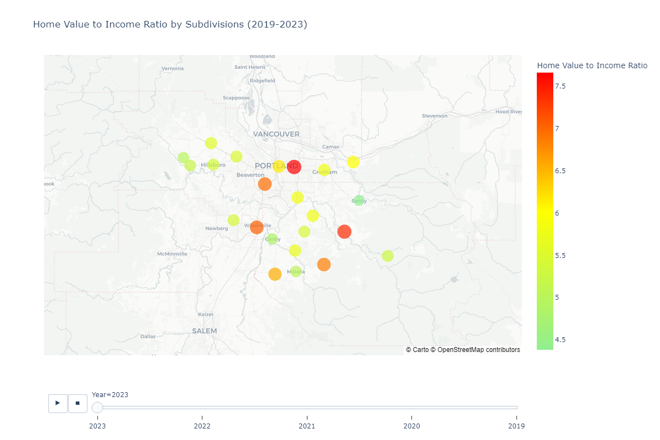
Source: U.S. Department of Housing and Urban Development. (n.d.)

Slide 14
Summary
Overall housing affordability in the Portland Metro Area has declined from 2019 to 2023. The data indicates that surging home values, higher mortgage rates relative, and escalating rents relative to incomes have worsened the issue. The affordability crisis is further exacerbated by limited housing supply, with strong demand has increasing market pressures. Despite rents remaining an affordable alternative to home-ownership, . Income growth is being outpaced by increasing rental costs. The data shows a persistent downward trend in overall affordability, and without targeted interventions to address supply, income disparities, and market pressures, the affordability crisis impacting the Portland Metro area can be expected to continue.

Slide 15
Citations
Federal Reserve Bank of St. Louis. (n.d.). ALFRED: Archival Federal Reserve Economic Data. Retrieved February 4, 2025, from https://alfred.stlouisfed.org/
U.S. Census Bureau. (n.d.). United States Census Bureau. Retrieved February 4, 2025, from https://www.census.gov/
U.S. Department of Housing and Urban Development. (n.d.). U.S. Department of Housing and Urban Development (HUD). Retrieved February 4, 2025, from https://www.hud.gov/
Herbert, C. E., Hermann, A., & McCue, D. (2018). Measuring housing affordability: Assessing the 30 percent of income standard (Working Paper). Joint Center for Housing Studies of Harvard University. https://www.jchs.harvard.edu/sites/default/files/Harvard_JCHS_Herbert_Hermann_McCue_measuring_housing_affordability.pdf

